Slide 1

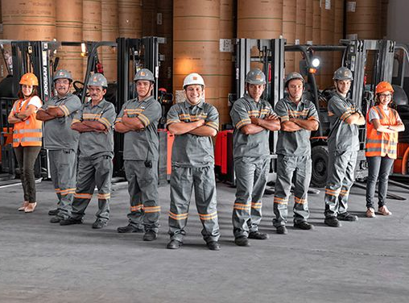
Herfitak Web
Full Stack Web Development Using .Net .
Minya Branch .

Slide 2

Team Member
Mohamed Salah
Abdelrahman Gomaa
Ahmed Mohamoud
Karen Wafik

Slide 3

Agenda
Introduction
Survey
Diagrams
Tools
Technology
Roles
Demo

Slide 4
Introduction
It is a service website aimed at craftsmen and clients. We work as an intermediary to help both parties, provide the required services and use technology in all areas of our daily life.

Slide 5
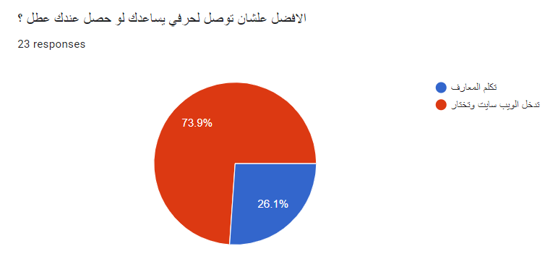
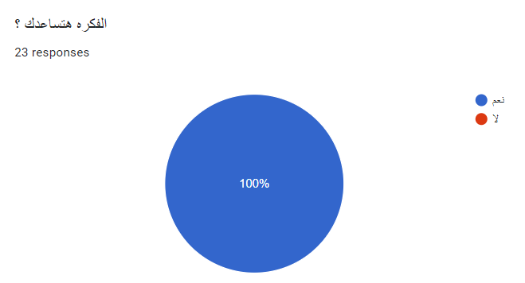
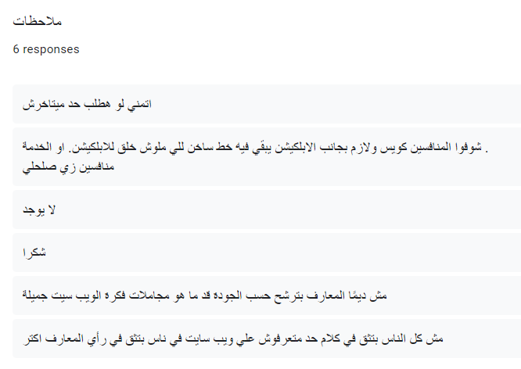
Survey for Clients

Slide 6
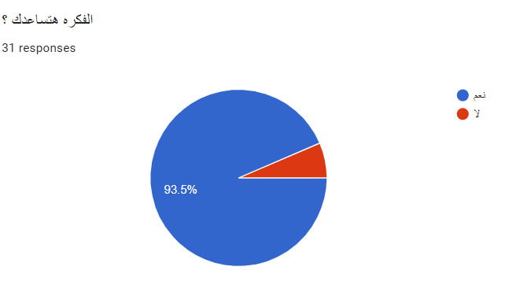
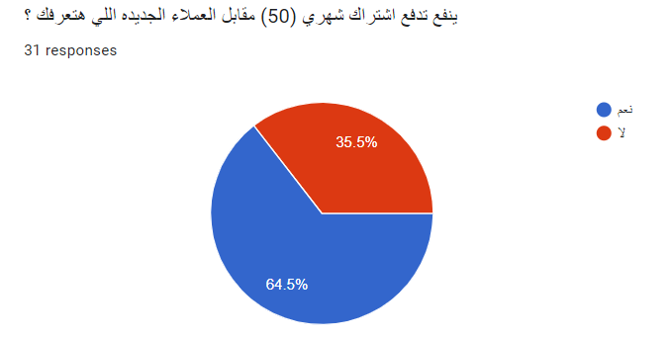
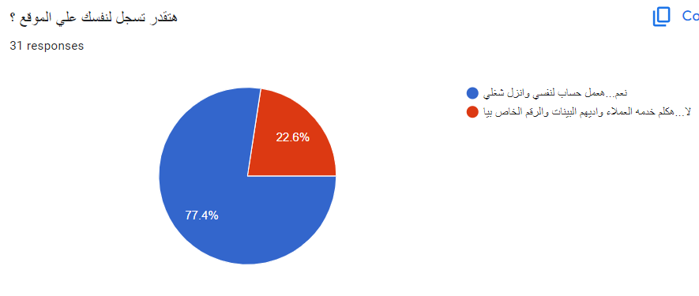
survey for Craftsmen

Slide 7
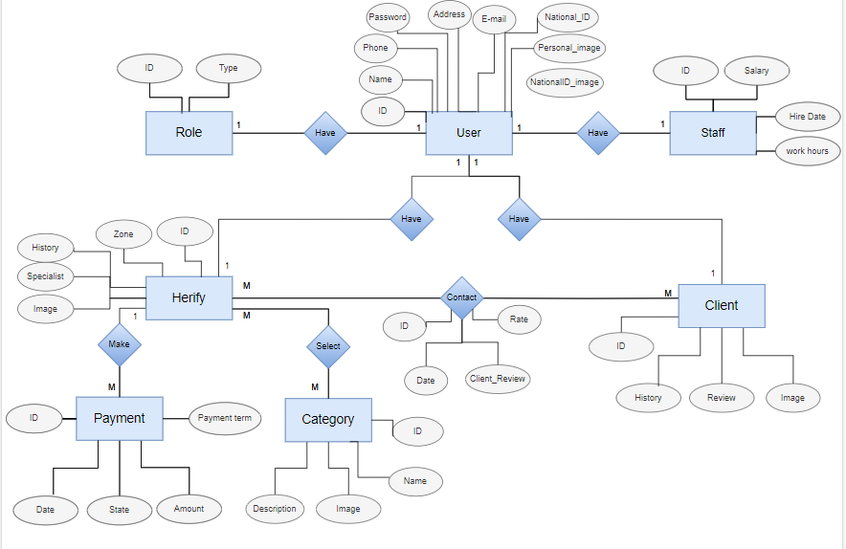
ERD

Slide 8
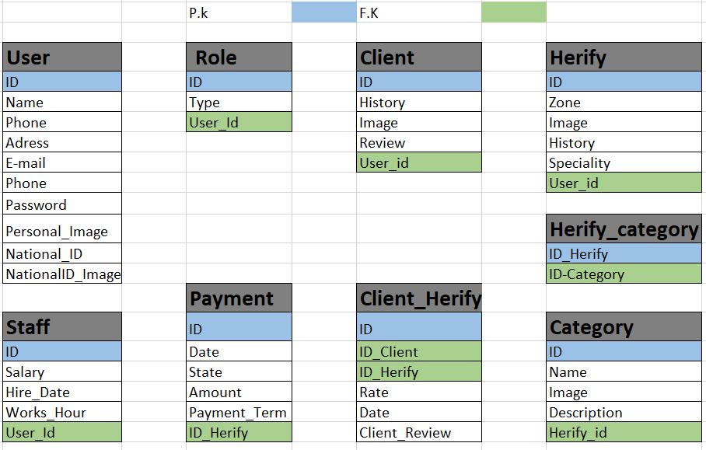
Mapping

Slide 9
Tools &Technologies
New Technologies
Front-End
HTML5
Back-End
ASP.NET Core
Database
SQL Server
CSS3
Bootstrap
TypeScript
Angular 17
Web API
EF Core
.Net Identity.
Signal R Chat community
Jwt Security.
Ngx for translation.
Payment integration with. paymop.
Dark &Light Mode.

Slide 10
Roles
Admin
It has access to all accounts and the dashboard, including adding, modifying, and deleting operations
Account :
Username: (mohammed.eldeberky@gmail.com) Password : (Salah@123)
Staff
It has access to the dashboard and Craftsmen accounts for addition and modification only
Craftsmen
He has access to create an account for him and modify it only
Client
He only has access to create and edit his account and can add a review to the craftsman

Slide 11
Version Control
GitHub: https://github.com/MoSalah14/Herfitk

Slide 12
Thank you

